Slide 1
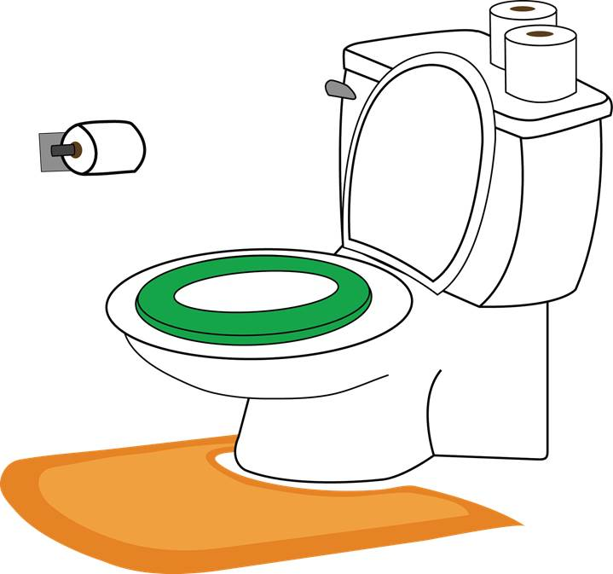
Potty Training
Notes:
Please see the How to Use Personalized Stories document for more information on how to edit and display this PowerPoint presentation for your child.
Please customize this template to best help your child by:
Modifying the template to use your child’s name
Using language that is familiar to your child
Including items that are of great interest to your child
Adding photos of your child or family to all of the blue frames in this template.
Adding photos and new slides from your own child’s life to this template.
Changing any of the text, photos, or images in this template with photos or images that are more meaningful to your child

Slide 2
Sometimes I need to pee or poo. I have a feeling in my body when I need to pee or poo.

Slide 3
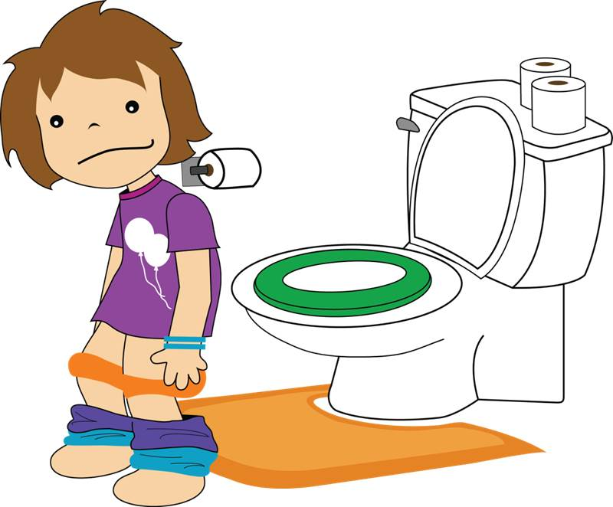
When I feel like I have to pee or poo, I go to the bathroom. There I take down my pants and underpants.

Slide 4
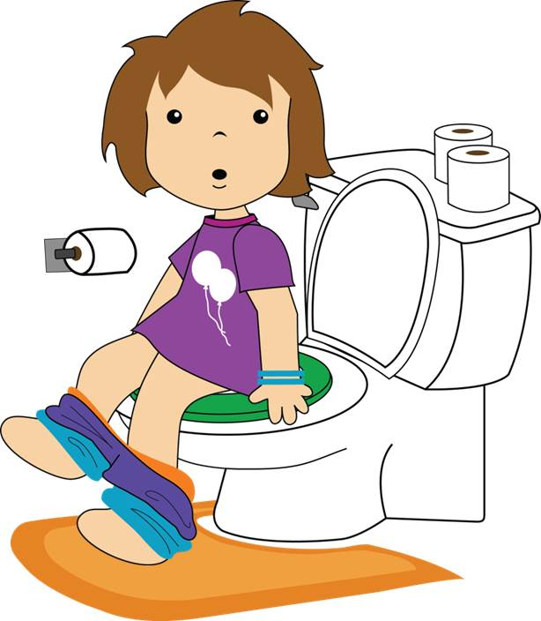
I sit on the toilet. When I’m on the toilet I can go pee or poo.

Slide 5
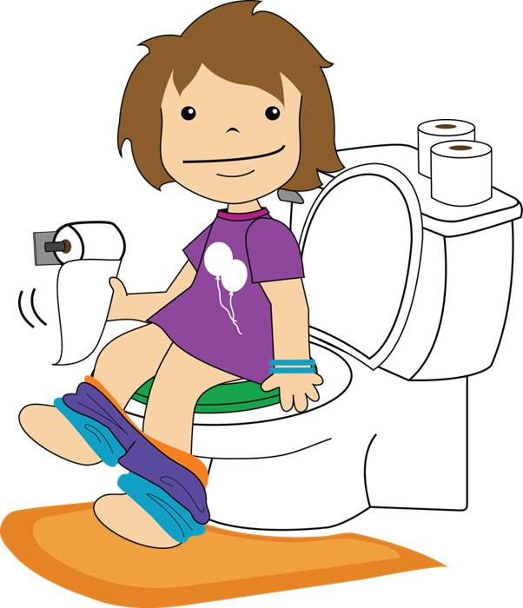
After I make a poo in the toilet, I need to use toilet paper to wipe my bottom to keep my body clean. I can put the toilet paper in the toilet.

Slide 6
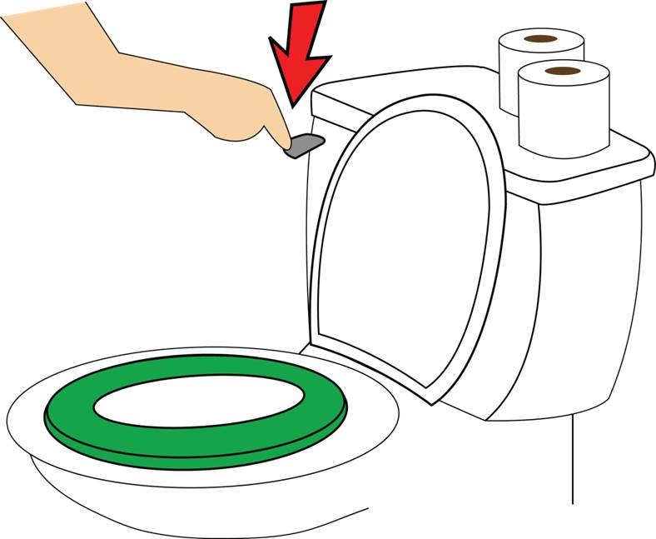
After I pull my pants and underpants back up, I can flush the toilet.

Slide 7
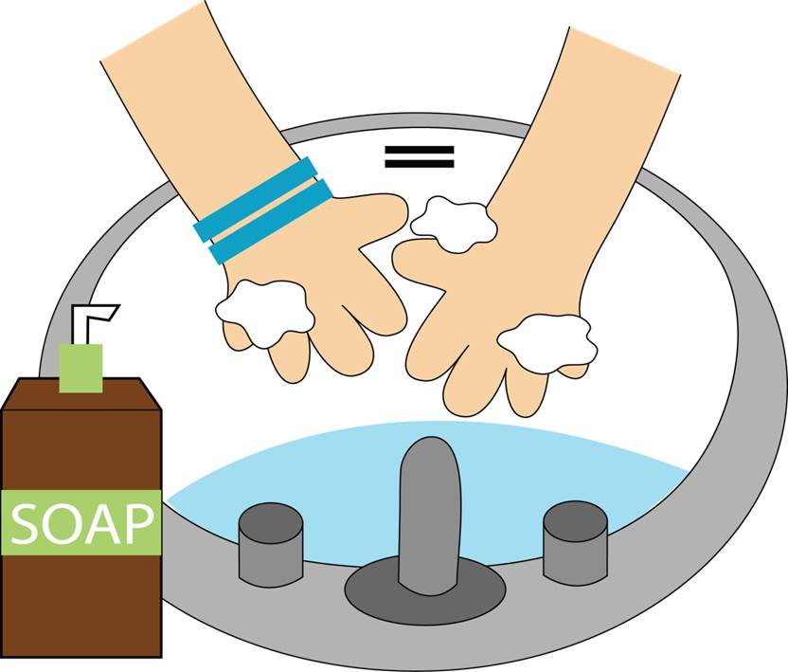
After I pee or poo in the toilet, I need to wash my hands. Keeping my hands clean keeps me healthy.

Slide 8
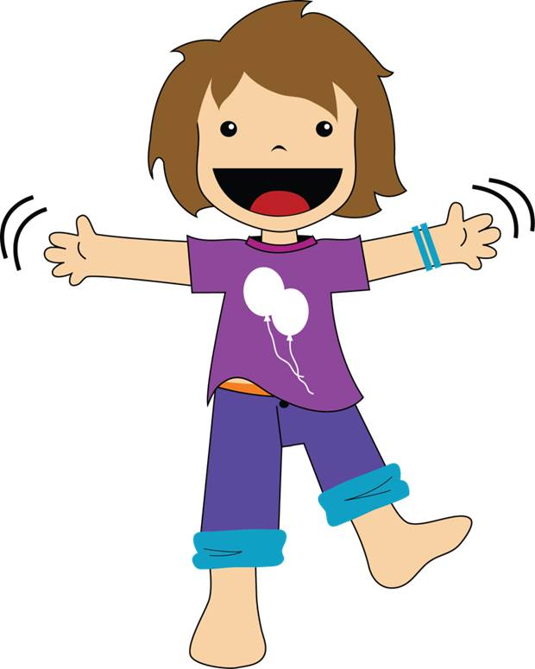
When I go pee or poo in the toilet, I have clean underpants. That is great!

Slide 9
Sometimes I might have an accident. That is okay. I’ll just keep practicing to make it to the toilet.

Slide 10
I can use the toilet. I’m so proud of myself!

